Slide 1

Data Visualization- Group 01 (MIS 6380.0U1) Kannupriya Heli Madani Mayur Kumar Tikmani

Slide 2
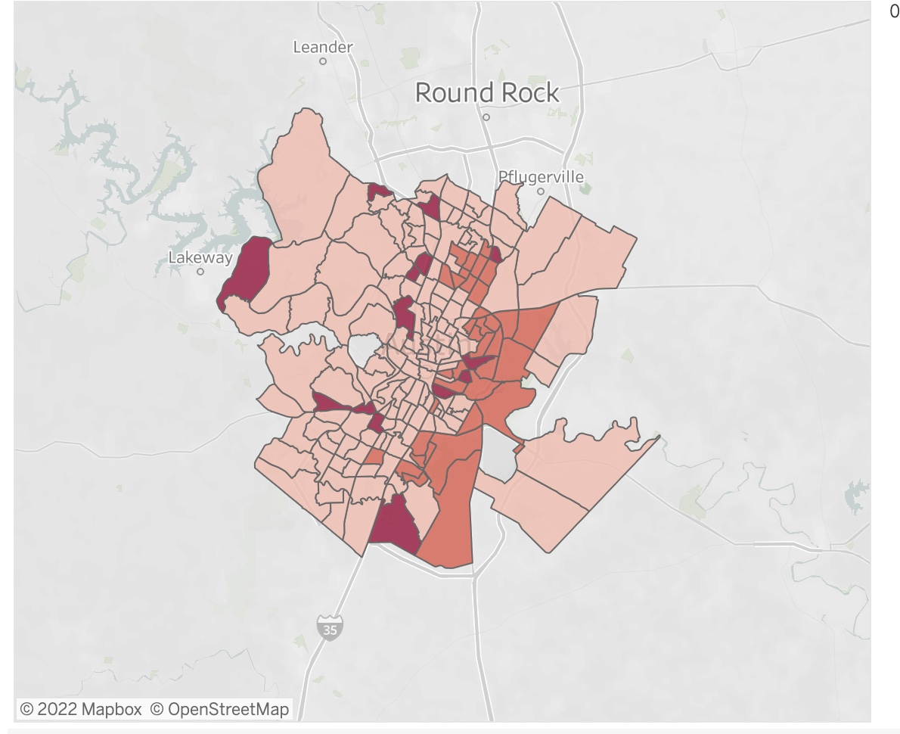
Austin Code Covid-19 complaint case (Primary dataset) Daily COVID-19 count (Secondary dataset)

Slide 3

With the domestic and international spread of (COVID-19), much attention has been given to estimating the pandemic risk, fatalities, effect on business.
We propose the novel application, to provide a visualization of the COVID-19 – related complaints filed in Austin, Texas for alleged violations of the CDCs’ STANDARD from the year 2020 to 2022 and no. of daily covid case counts in Austin

Slide 4
Dataset Glance
We will pay close attention to the column Open date, which will track the number of complaints received in various months of 2020 and 2021. Our dataset's third column "Type of Business," gives insight into the environment in which COVID-19-related complaints were made. The dataset's fourth column Type of Complaints lists the rules that were breached and resulted in the case being recorded.
Depending upon the severity of their violations, the Austin, Texas, government has specified several actions that will be taken against them. Address, council district, location, gives us a brief idea about the location where the complaints were registered.
COLUMN= 13
ROWS= 10,288

Slide 5

Hypothesis 01: Whether more complaints were registered in March 2020 compared to the number of complaints registered in 2021?

Slide 6
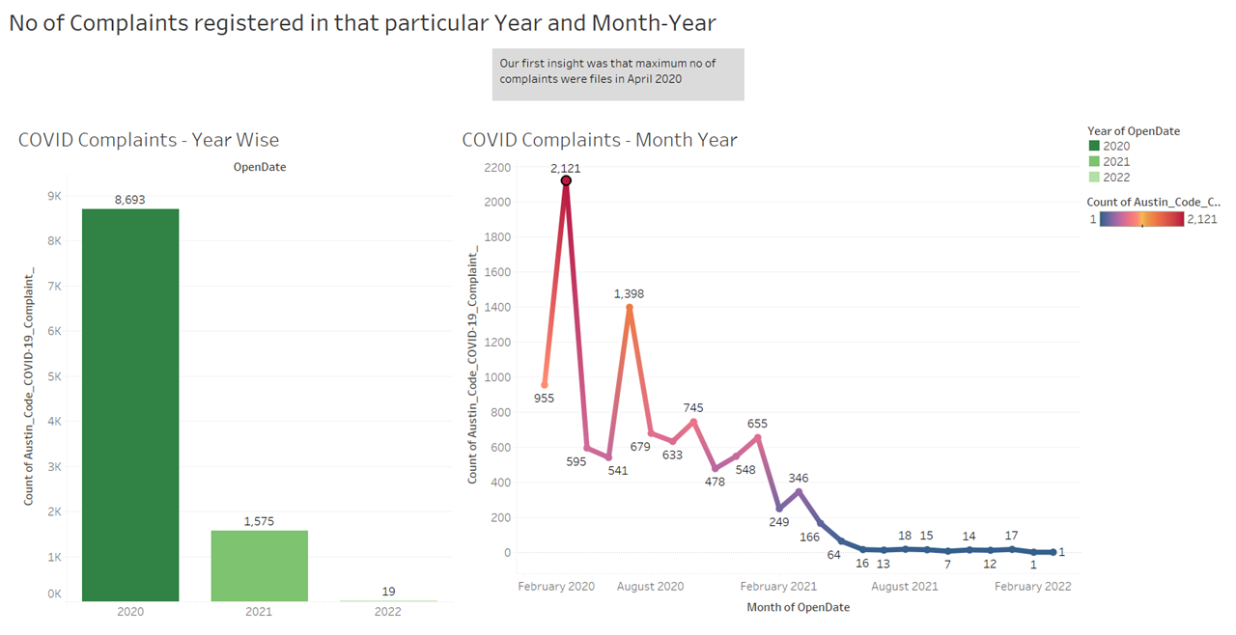

Slide 7
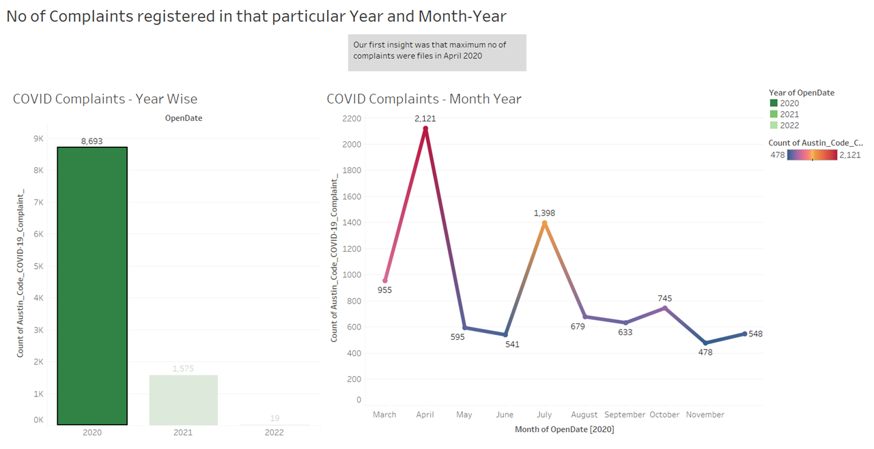

Slide 8
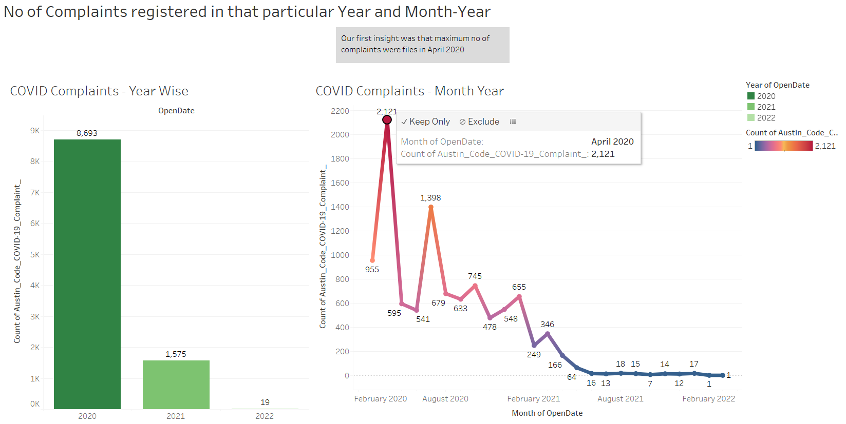

Slide 9
Insights:
Apr. 2020
Maximum complaints were filed in April 2020, thus our first hypothesis, which claimed that the most complaints were filed in March 2020, failed.
2021 and 2022
And the year 2020 had the most complaints when compared to the year 2021 and 2022. April 2020 had the highest no. Of cases registered, after which there was a progressive decline in COVID complaint instances.

Slide 10
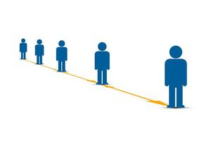
Hypothesis-02: Was social distancing the type of complaint that was registered maximum?

Slide 11
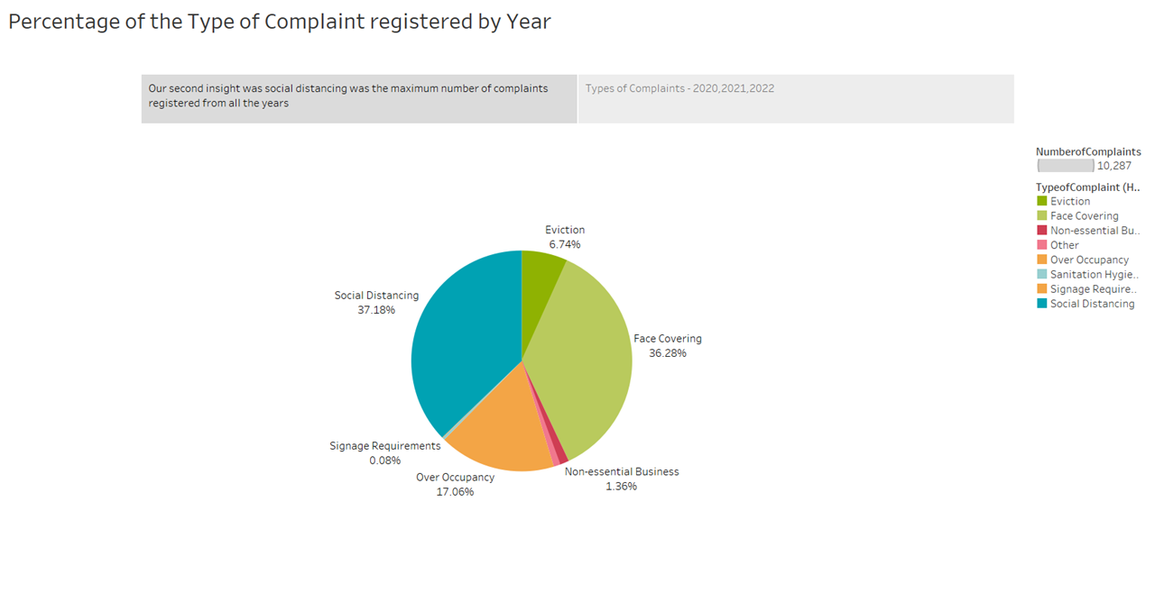

Slide 12
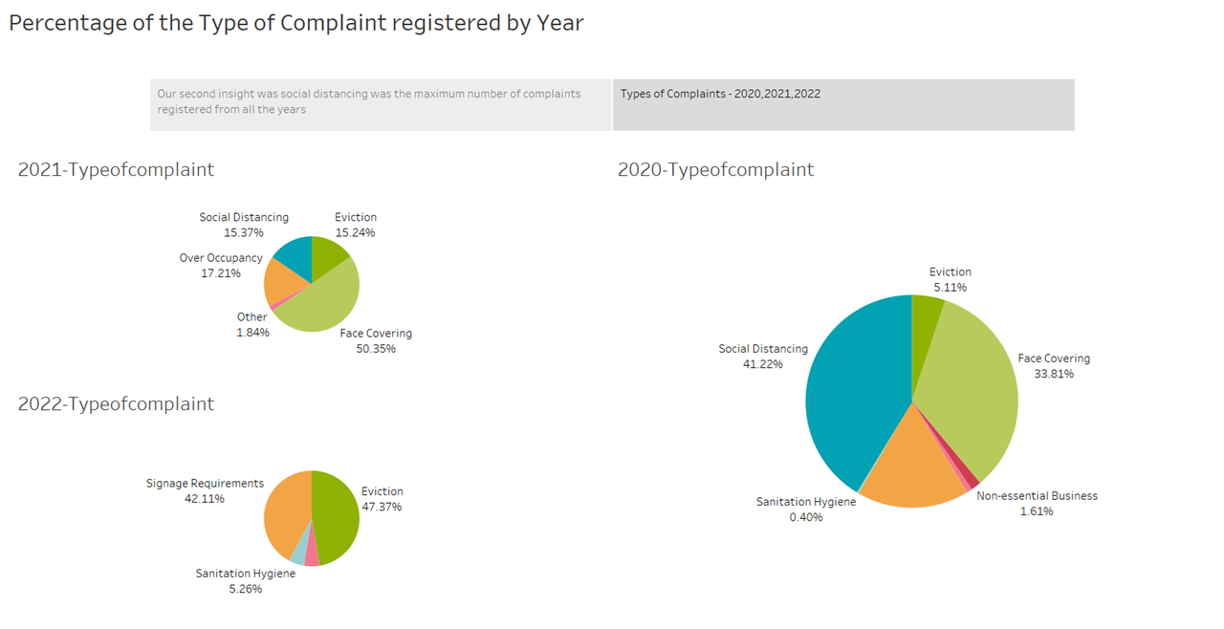

Slide 13

Insights:
overall social distancing accounts for the greatest proportion of complaint files, demonstrating that our second hypothesis was correct.
social distancing = 37.18 %
face covering = 36.28 %
2020= Social distancing > face covering
2021 = Social Distancing < Face Covering
2022 = eviction

Slide 14

Hypothesis-03: Were the highest number of complaints registered by residents?

Slide 15
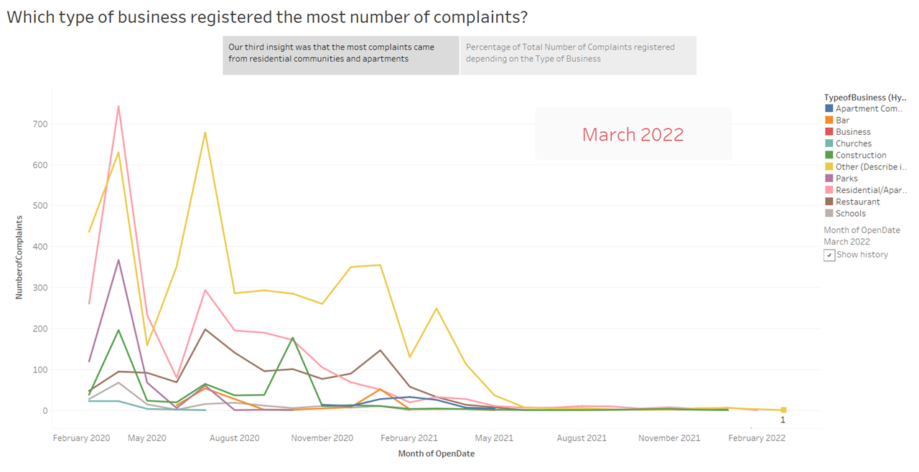

Slide 16
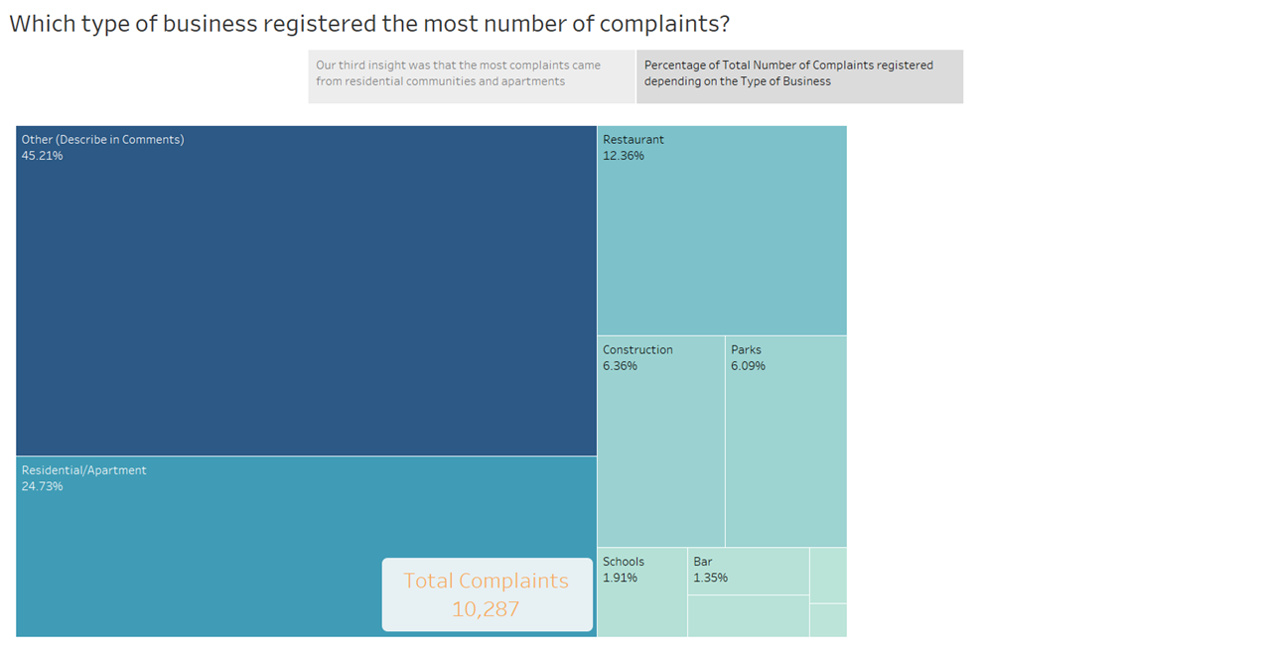

Slide 17
Insight:-
the category classified as OTHERS was the one who filed the maximum no. of total complaints over the period 2020-2022 which accounts for 45.21% of total no. of complaints filed.
There were major fluctuations in the no. of complaints filed by different businesses. However, the Highest no. of complaint recorded was in April 2020 by residents.

Slide 18
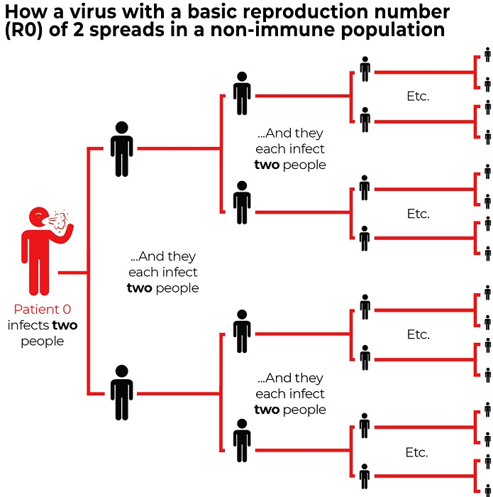
Hypothesis -04 Is there a positive relationship between the number of complaints of social distancing and the number of COVID cases?

Slide 19
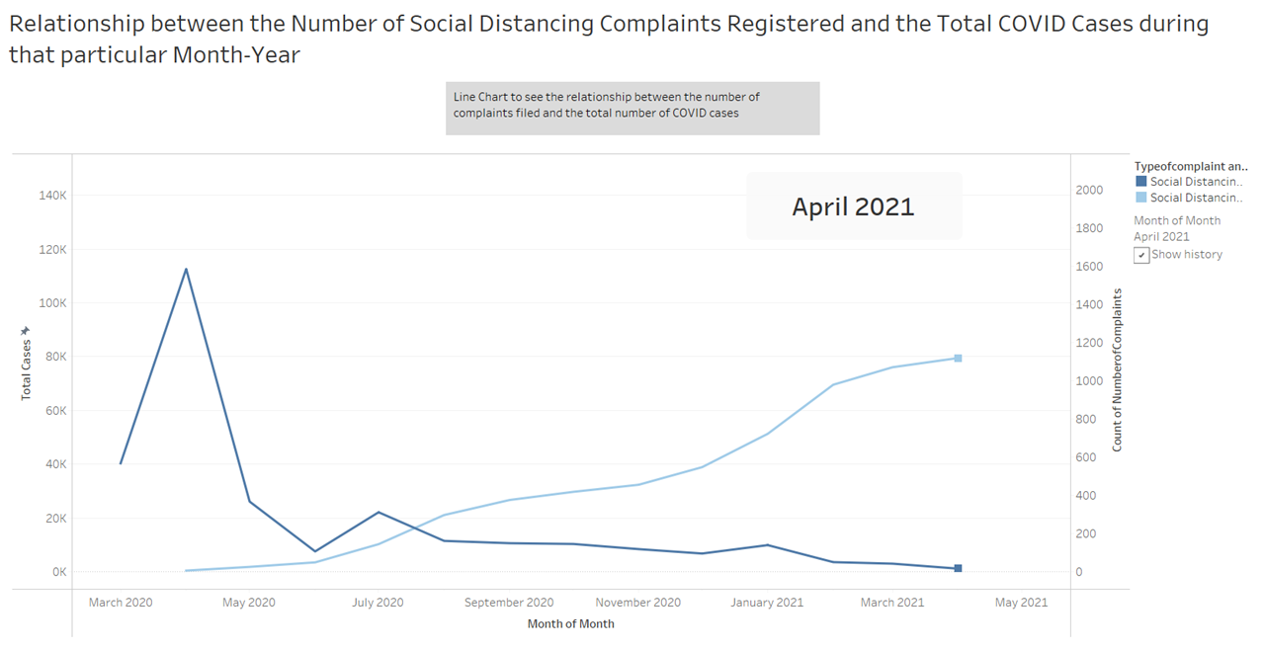

Slide 20
Insights:
No consistent relation between the number of social distancing complaints and the number of covid instances. Thus, our hypothesis 04 failed
Number of social distancing instances increased from March to April 2020, the overall number of cases fluctuated for total Covid Cases. However, as we approach May 2020, we can vividly observe the negative relationship between the two.

Slide 21

Hypothesis-05: Were no inspection was performed in majority of the inspection?

Slide 22
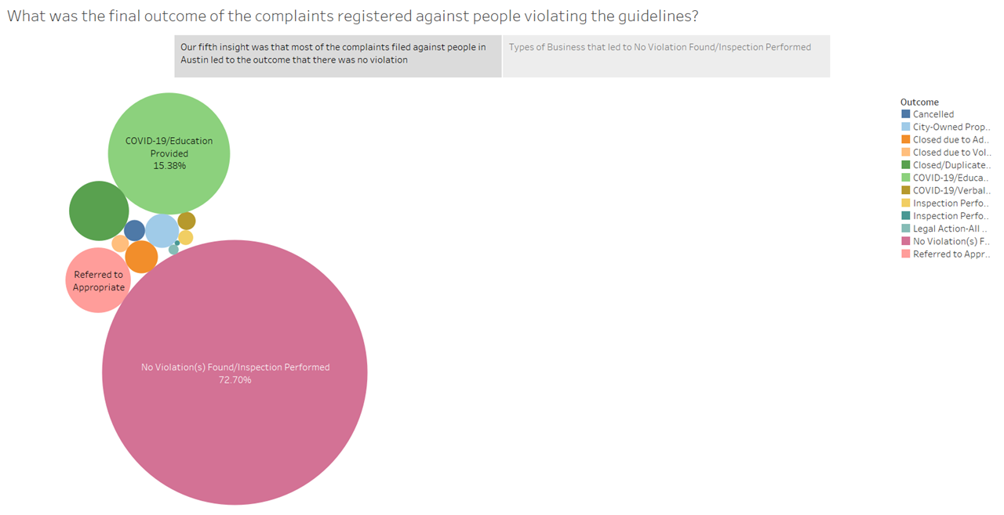

Slide 23
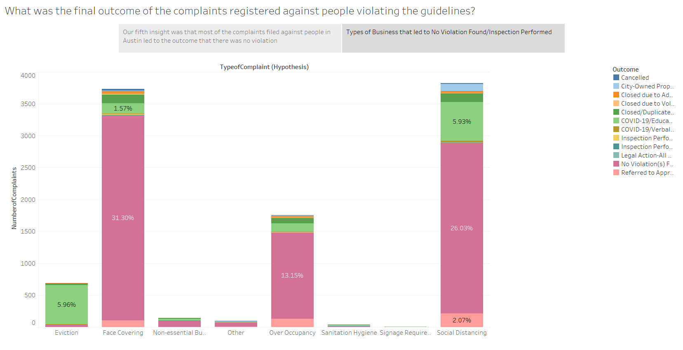

Slide 24

Insights:
No violation was detected in most of the complaints. Thus, our hypothesis passed.
Max. outcome of the complaints, no violation was found which accounts for 72.70 percent, followed by the outcome of delivering education linked to COVID-19, which accounts for 15.38 percent.

Slide 25
Hypothesis | Result
Hypothesis 01: Whether more complaints were registered in March 2020 compared to the number of complaints registered in 2021? | Failed, highest no. Of complaints were recorded in April 2020
Hypothesis 02: Was social distancing the type of complaint that was registered maximum? | Passed, overall social distancing was the highest no. Of complaint
Hypothesis-03: Were the highest number of complaints registered by residents? | Failed, highest no. Of complaints registered by category 'others'
Hypothesis 04: Is there a positive relationship between the number of complaints of social distancing and the number of COVID cases? | Failed, there is no positive relationship
Hypothesis 05: Were no violation was performed in majority of the inspection? | Passed, no violation accounts 72.70% for the total no. Of outcomes

Slide 26

As the Covid-19 cases increases in 2020, the highest cases were recorded in April 2020, and with time the cases decrease.
We were more interested to know if there is a positive relationship with covid-19 complaints about social distancing, face covering etc, with no. of covid cases recorded, as with more violations of CDC rules, the cases should increase, but while the number of incidents of social distance grew from March to December 2020, the total number of Covid Cases varied. However, as we approach March 2021, we can clearly see the two's unfavorable relationship.
There is no direct proportional relationship between the two and there must be other factors, we should introduce to know what CDC rules should consider to corelate with increase of COVID-19 cases like population density, covid testing frequency etc.

Slide 27

Thank you and stay safe :)
Primary dataset: Austin Code COVID-19 Complaint Cases
Link: https://data.austintexas.gov/Public-Safety/Austin-Code-COVID-19-Complaint-Cases/4p54-9544/data
Secondary dataset: Daily Counts
Link: https://atc-covid19data-austin.hub.arcgis.com/datasets/daily-counts-public-view/explore

